Slide 1

WAVELET
EVOLUTION-X
The
WAVELET
- a hands-off approach -

Slide 2
WAVELET
?
What is
EVOLUTION-X
The
WAVELET
- a hands-off approach -
- an introduction -

Slide 3

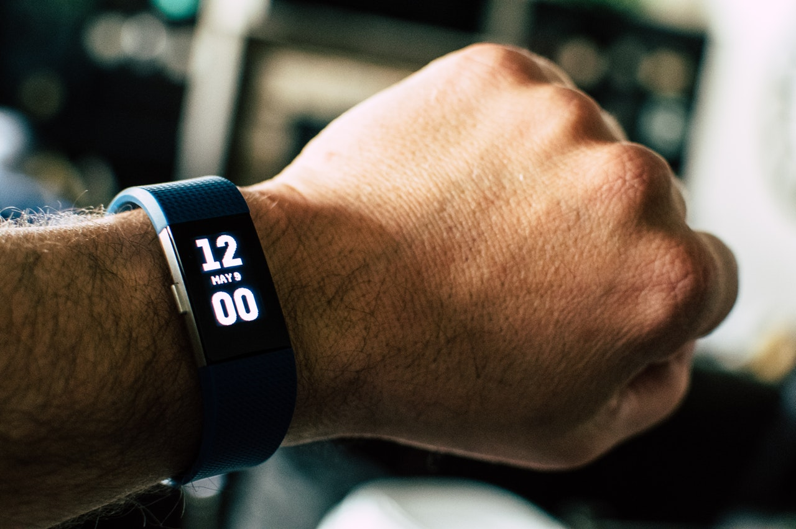
WAVELET
?
?
What is
What is
WAVELET
The
The
A
- an introduction -
- an introduction -
Wearable remote
Motion based controller
Portable input interface

Slide 4







UNDER THE HOOD...
Bluetooth
Pair & Control Code Transmission
Sensor(s)
Processor
Target Device
Gesture Detection
Gesture Recognition
Gesture to Code Conversion
Code Processing
Output
Infrared (IR)
Point & Control Code Transmission

Slide 5
Prototype Construction
Base Model:
Motion Sensor: Accelerometer & Gyro meter
Addons are used to expand functionality by adding Resistive Sensing, Flex Sensors, Heart Rate Sensors, Distance, etc
Sensor(s)
Gesture Detection

Slide 6
Prototype Construction
Initial Stages:
Arduino Lilypad ATMEGA 328
Final Product:
Custom Printed PCB with a processor
Processor
Gesture Recognition
Gesture to Code Conversion

Slide 7
Prototype Construction
Point & Control:
via Infrared (IR)
Lower Power Consumption
Cloning Signals
Line Of Sight only
Pair & Control:
via Bluetooth (BT)
High Power Consumption
High Accuracy
Transmission
Point & Control Code Transmission
Pair & Control Code Transmission

Slide 8
Innovative?
What makes it
use of hands, easy intuitive operation
modular design, cost-effective
portable, everyday wear
universal reception
simplicity

Slide 9
APPLICATIONS?
What are its
a wearable controller for household appliances
an assistive technology for the disabled
a universal remote for any IR device
a Bluetooth HID for use with computers
an all-in-one input interface to make man-machine communication simple and intuitive
An aid for the disabled

Slide 10

Implementation Plan
Phase 1: Preparation
Phase 2: Functionality
Phase 3: Integration
Phase 4: Finalization
Research ✔
Acquiring Components ✔
Bluetooth ✔
Infrared ✔
Motion Detection ✔
Gesture Detection ✔
Adding Form
Merging Components
Adding Power & Battery
Finalizing Product

Slide 11
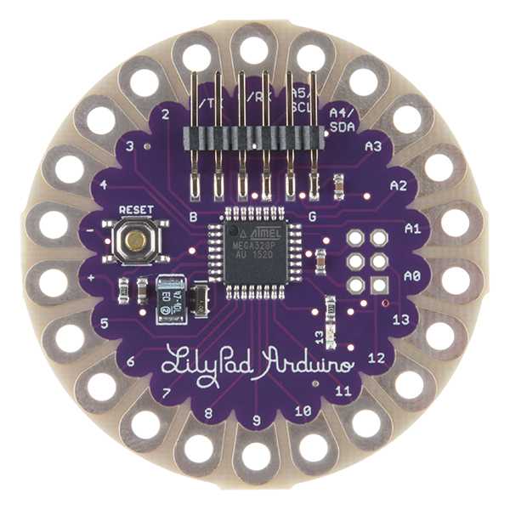
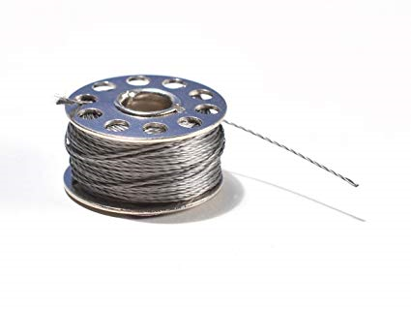

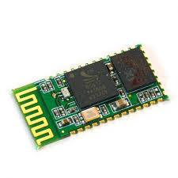
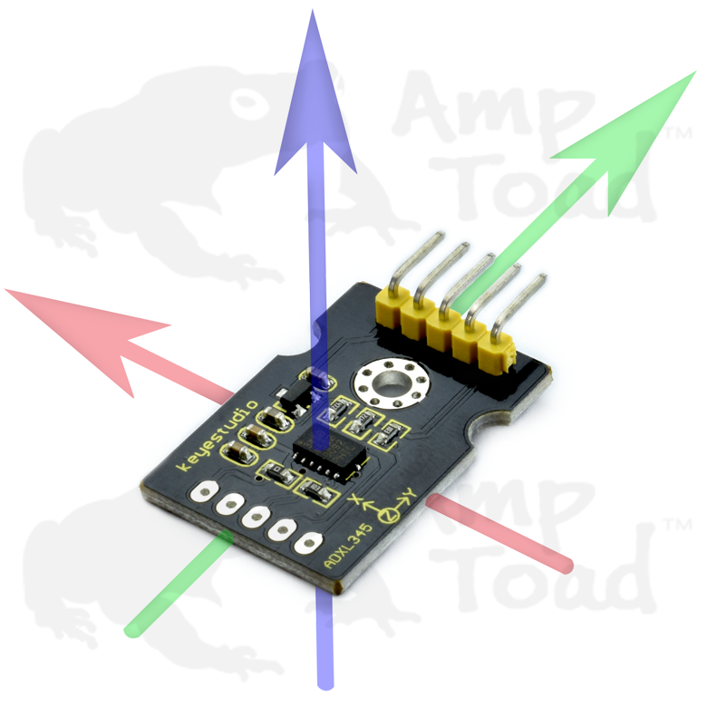
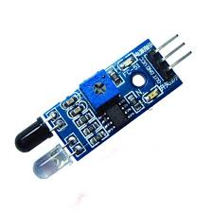
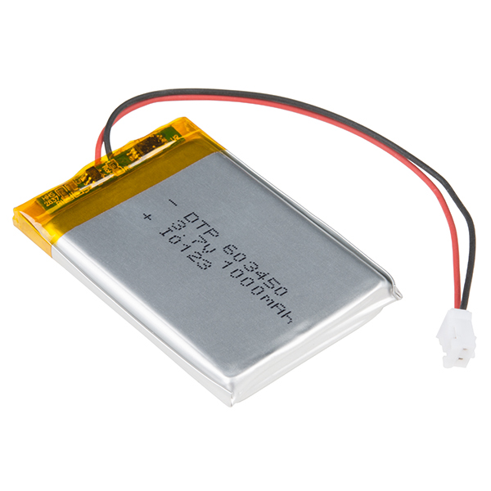
Early Development

Slide 12
Thank You!

